Slide 1


Cooper Dahlberg
David Sincyr
Ethan Esber
Kevin Finley
Michael Rumohr
Michael Taylor
Burger Breakout

Slide 2
Overview of Burger Breakout
MUR (4/26): Need to add to overview slide
(1-2 slides)
2D Side Scroller
Featuring running, jumping, and fighting
Uses traditional controls to move the character around for familiarity
Fun gameplay with mesmerizing visuals
Original drawn art, characters, and enemies.
Enjoy original background music while playing
Retro pixel theme for a nostalgia overload
Original hand made animations

Slide 3
Overview of Burger Breakout
MUR (4/26): Need to add to overview slide
(1-2 slides)
Throw food and drinks at enemies to defeat them
Escape the kitchen through various levels playing as a burger
Each level will have varying types of obstacles
Fire
Falling platforms
Falling food
Some obstacles or enemies can instant kill the player for added difficulty
Beware of the mouse!
Varying levels types such as:
Run and gun
Avoid the hazards

Slide 4
Updated User Stories
MUR (4/26): Updated User Stories
(1-2 slides)
As a player, I should be able to move my character through the world so that I can progress through it and explore how I want to.
As a player I want my character to have animations so that the controls feel more realistic.
Playing as a burger character, I want to be able to throw food like cheese, tomatoes, or use French fries as a weapon to be able to defeat my enemies or use them to be able to run away
As a player I want to be able to shoot food so that I can defeat my enemies.
As a player I want to be able to pick up items so that I can use them.
As a player I want to be able to use the items I pick up so that I can gain power ups.
As a player I want enemies I can engage with so that I can fight them.
As a player, I want to be challenging while playing the game so that it does not seem boring or too easy.
As a player, I want to be rewarded for progressing through the game so that I have more motivation to continue playing it.
As a player, I want to be able to fight against a variety of enemies so that I do not get bored with having to kill the same enemies repeatedly for the whole game.
As a casual gamer, I want the game to be easy to pickup / understand so that I am able to have fun without having to remember how to play the game and or its mechanics.
As a player of modern video games, I would like the gameplay to be visually appealing so that will make the game feel polished

Slide 5
Updated User Stories
MUR (4/26): Updated User Stories
(1-2 slides)
As a player, I want to have options that allow me to customize things like controls, volume, or graphics so that I can adjust the game to suit my preferences.
As a player I want an environment to go through so that I can progress through the game.
As a colorblind player, I need the game to have a colorblind mode because otherwise, I am not able to distinguish many game objects rendering the game quite frustrating.
As a player I want to be able to exit the game so that I can pick it up at another time.
As a player I would like to start a new game so that I can begin the game.
As a player, I want to be able to save my current game state at any time so that I can resume later
As a player I want there to be a button dedicated to pausing the game.
As a player I want to be able to load my previously saved game so that I can continue where I left off.
As a player who enjoys music, I would like for the game to have complete sound design, so that the game doesn’t feel dull.
As a player, I need the interface for the game to clearly display important information such as health, lives, or score so that I can understand what is happening in the game and how I’m doing.
As a competitive player, I would like to save high-scores or achievements of some kind so that I and others may compete against those scores.
As a player of modern video games, I would like the goal of the game to be clear.
As a player I want an enemy to go against me so that I feel more challenged.

Slide 6
Important Functional & Non-Functional Requirements
MUR (4/26): Need to update slide.
(1-2 slides)
x

Slide 7
Important Use Cases
MUR (4/26): Need to update slide.
(2-3 slides)
x

Slide 8
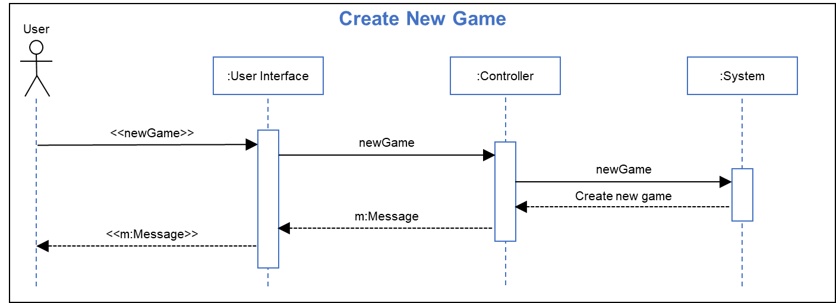
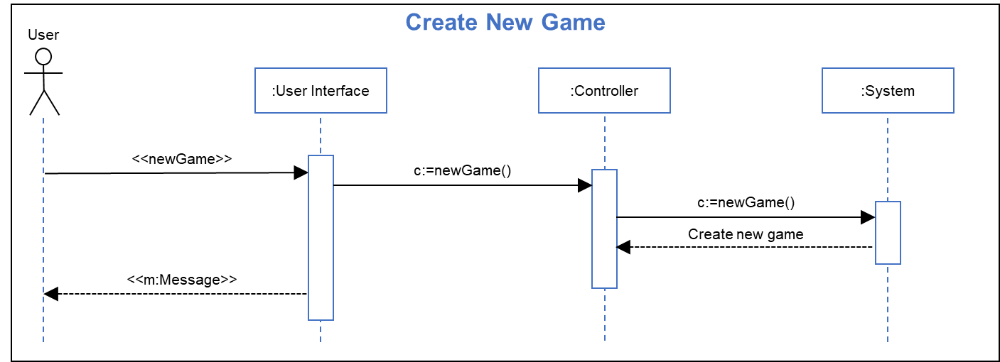
Important Sequence Diagrams: Create New Game
Analysis Sequence Diagram: Design Sequence Diagram:
Sequence Step Description:
Title: Create New Game
Actor(s): User
Precondition: User has selected “yes” at prompt to create new game
Outcome: A new game is started at the start of level one
User Actions System Actions
3. User clicks UI “yes” button 4.1. Game UI generates a new game message and sends it to the message controller
4.2 Message controller sends the new game call to the game controller
4.3 The game controller initializes a new game
5/6 The user interface displays the game view
MUR (4/26): Slides updated
(2-4 slides)

Slide 9
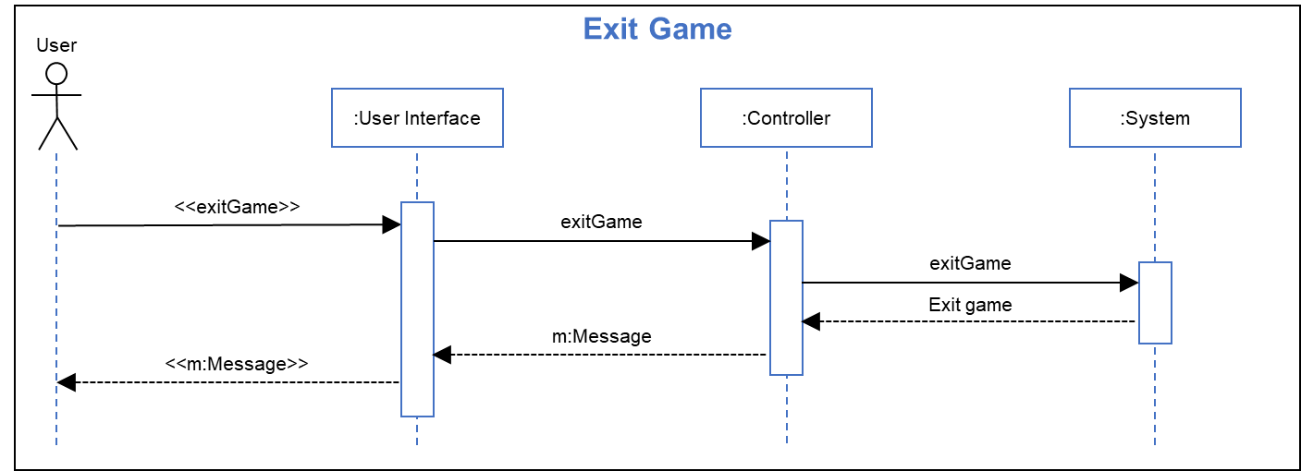

Important Sequence Diagrams: Exit Game
Analysis Sequence Diagram: Design Sequence Diagram:
Sequence Step Description:
Title: Exit Game
Actor(s): User
Precondition: User has selected “yes” at prompt to exit game
Outcome: The current game session is ended and the title screen is shown
User Actions System Actions
3. User clicks UI “yes” button 4.1. Game UI generates an exit message and sends it to the message controller
4.2 Message controller sends the exit game call to the game controller
4.3 The game controller ends the current game
5/6 The user interface displays the initial title screen
MUR (4/26): Slides updated
(2-4 slides)

Slide 10


Important Sequence Diagrams: Save Game
Analysis Sequence Diagram: Design Sequence Diagram:
Sequence Step Description:
Title: Save Game
Actor(s): User
Precondition: User has selected “yes” at prompt to save game
Outcome: The current game session state is saved and the game session is resumed
User Actions System Actions
3. User clicks UI “yes” button 4.1. Game UI generates a save game message and sends it to the message controller
4.2 Message controller sends the save game call to the game controller
4.3 The game controller saves the current game
5/6 The user interface return to the game view
MUR (4/26): Slides updated
(2-4 slides)

Slide 11
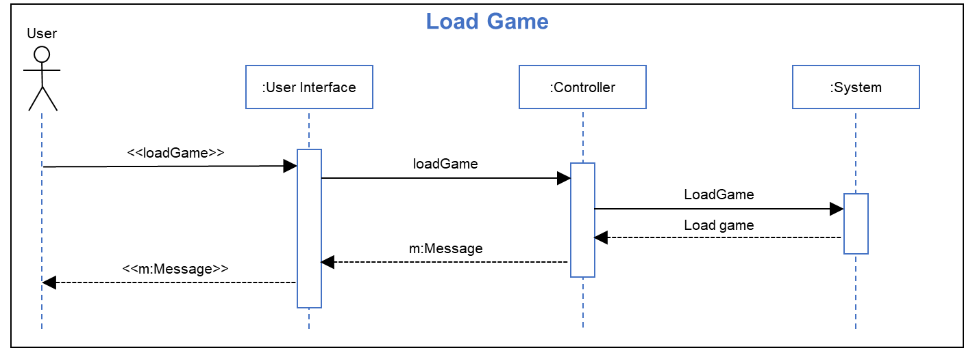
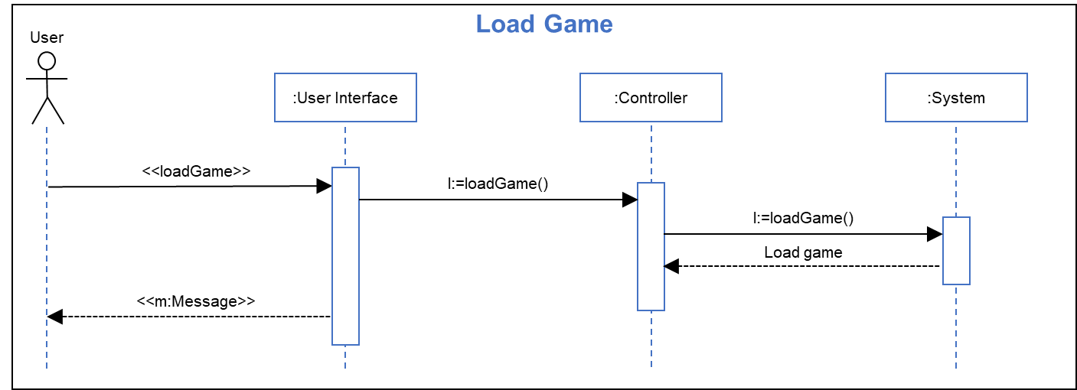
Important Sequence Diagrams: Load Game
Analysis Sequence Diagram: Design Sequence Diagram:
Sequence Step Description:
Title: Load Game
Actor(s): User
Precondition: User has selected “yes” at prompt to load game
Outcome: The current game session state is saved and the game session is resumed
User Actions System Actions
3. User clicks UI “yes” button 4.1. Game UI generates a load game message and sends it to the message controller
4.2 Message controller sends the load game call to the game controller
4.3 The game controller loads the game data previously saved
5/6 The user interface return to the game view
MUR (4/26): Slides updated
(2-4 slides)

Slide 12
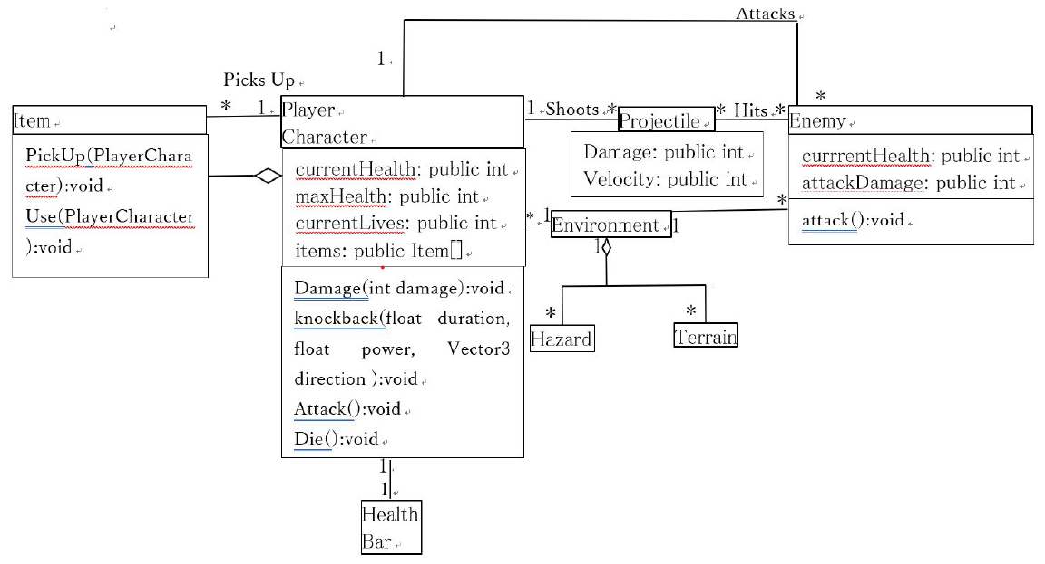
Domain Model
MUR (4/26): Updated

Slide 13
Detailed Design Diagrams
MUR (4/26): Need to update slide.
(1-2 slides)
x

Slide 14
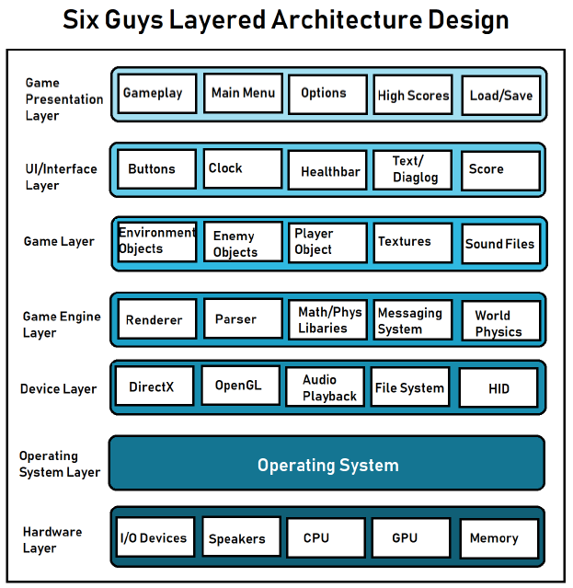
Architecture Design Used
MUR (4/26): Updated CHD

Slide 15
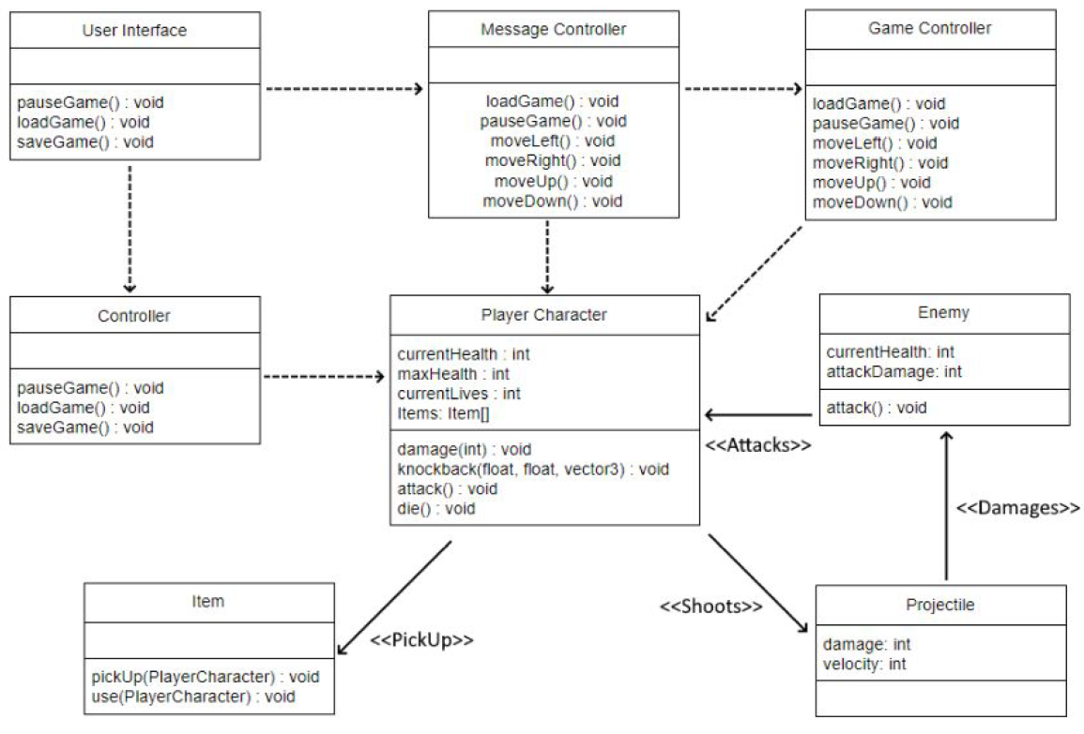
Design Patterns Used
MUR (4/26): Updated

Slide 16

Configuration Plans
MUR (4/26): Need to update slide.
(1-2 slides)
MRT (4/27): CF updated
Management
Agile Process
Sprints
Scrum Master, Product Owner, Developer
ZenHub
Activities
Configuration Items
GitHub
ZenHub
Unity3d Engine
Documentation
Discord
Notes:
The configuration plan for Burger Breakout can be broken down into a few key components.
The development of Burger Breakout is primarily managed by following the Agile Process. The Agile Process allows us, Team Six Guys, to quickly develop new and improved versions of Burger Breakout through Sprints.
BB chips away at development in bursts of 1 to 2 week sprint intervals, completing sets of user stories within these sprints.
The sprints are managed by the Scrum Master, who oversees Team Six Guys follows the agile methodologies.
The Product Owner ensures the team is completing tasks, as well as updating user stories with the product backlog.
These roles rotate through the members of Team Six Guys, with the rest of the member solely focused on development.
BB keeps organized by utilizing ZenHub to keep track of user story developments throughout sprints. Team Members can easily see which user stories are assigned to them, as well as what other team members are working on as well.
A series of activities keep BB running on track. Let’s break down a few of the important configuration items of BB.
The heart of BB lives on GitHub. By utilizing Git, Team Six Guys can all easily develop BB without stepping on one another's toes.
As previously mentioned, BB relies on ZenHub to organize our user stories, and keep track of what is being developed during each sprint.
The Unity3d Engine makes up the brains of BB. The development of BB would not have been possible without the underlying platform Unity provides. Using Unity, Team Six Guys was able to develop BB without having a ton of experience in game development.
In order to maintain BB collaboratively, Team Six Guys created lots of documents detailing the different aspect of the project, allowing for all members to have a clear focus of the products end goal.
While GitHub and ZenHub are fantastic for keeping project files up to date with one another, the team heavily relies upon Discord, a free chat platform, to discuss and communicate day to day topics revolved around the project.

Slide 17

Configuration Plans
MUR (4/26): Need to update slide.
(2-4 slides)
MRT (4/27): CF updated
Activities
Configuration Control
Status
Evaluation & Release
Schedule
Release & Deliverable
Resources
Unity Engine
Git
Maintenance
Notes:
As times change, so do ideas. With that said, BB is open to new ideas, and has a plan in place for the developmental changes of such ideas.
New ideas can be submitted on BB’s public GitHub page under the issues section. Once a new idea is raised, Team Six Guys will evaluate the new idea prior to the start of a sprint.
Should an idea be accepted, Team Six Guys will save the idea to the product backlog as a user story, and decide whether the new story should be implemented in the upcoming sprint, or a later sprint.
The status of these user stores, as well as any other BB development can be found on GitHub. In fact, all non confidential data of the project is freely available on GitHub.
To ensure BB is following the guidelines set forth by the configuration plan, this plan is audited prior to every release to ensure both BB is in accordance with the plan, but also to ensure the plan is up to date as well.
Speaking of releases, BB is built at the end of each sprint, and a new version released for each deliverable. With that said, on behalf of Team Six Guys, we are happy to announce the latest version of BB will be free to download on May 1st!
To touch upon the critical resources of BB, the game is built upon the Unity Engine, and project files are developed collaboratively with the use of Git. With an understanding of both, anyone can quickly catch up to speed on the insider view of BB’s development.
To conclude this segment of the presentation on Configuration Plans, I would like to briefly touch upon the plans for Configuration Maintenance. The plan is intended to be monitored each sprint, and updated as needed. Should an update occur, the change shall be notified via Discord, however the plan changes can also be viewed on GitHub. The configuration plan should thus allow BB to live on.
While this concludes a short summary of the Configuration Plans, a more in depth coverage of the plan can be found written in the Configuration Management Plan document.

Slide 18
Summary of Test Plan, Test Cases and Results
MUR (4/26): Need to update slide.
(2-4 slides)
x

Slide 19
Results of Focus Group & Usability Study
MUR (4/26): Need to update slide.
(2-4 slides)
The Good:
Comical, eccentric art style
Enjoyable, but needs more content.
Players compared the game to Mario and Sonic, with a fun theme.
Theme and character controls.

Slide 20
Results of Focus Group & Usability Study II
MUR (4/26): Need to update slide.
(2-4 slides)
The Bad:
Limited content, needs more enemies, levels etc.
Designed for PC, not a mobile app.
At the time of review, our Focus Group stated low interest in purchasing the app for money.
Theme may be limiting in terms of content.

Slide 21
Security and Privacy Concerns Addressed
MUR (4/26): Updated CHD
Unity3D Engine is constantly patched to secure newly discovered vulnerabilities
In March 2019, Unity received a patch to fix a vulnerability involving remote code execution. This affected all Unity versions on all versions of Windows.
Unity practices responsible disclosure and transparency, and continues to remain PCI compliant.

Slide 22
Security and Privacy Concerns Addressed II
Our game does not involve network capabilities, so security our concerns focus mainly on integrity of the gameplay by eliminating or mitigating exploitable bugs.
The player’s access to the system beyond the GUI is hidden away, or else it could be used to gain an unfair advantage.
Some developers leave some of the ease-of-development features hidden in the game in the form of cheat codes.
(e.g., infinite health cheat)
MUR (4/26): Updated CHD

Slide 23
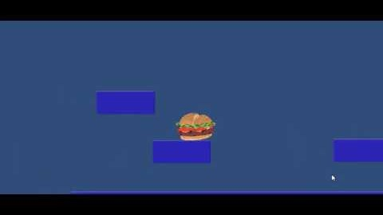
Mock-Up of Burger Breakout
MUR (4/26): Need to update slide.
(2-3 slides)
Still in the early development stage and will add the following features:
Mechanics
Enemies
Hazards
Scenery

Slide 24

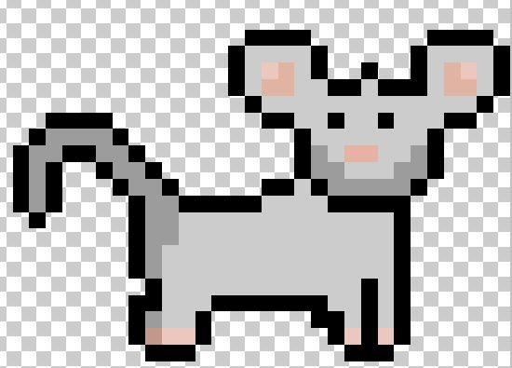
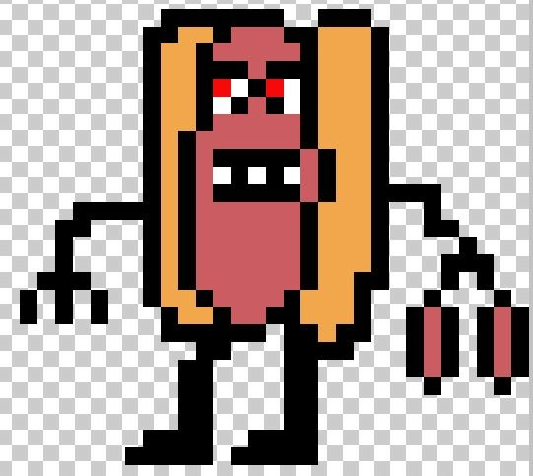
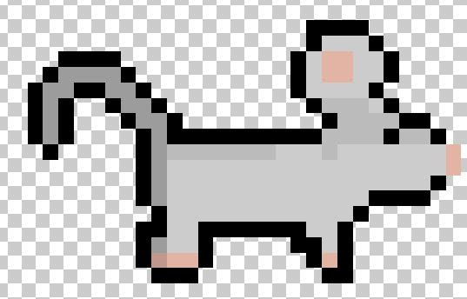
Early Concept Art: Characters
MUR (4/26): Kept character slides in case we want to reuse
Main Character – needs to be named
Mouse NPC
Hot Dawg Boss –Sausage link Nunchaku wielding

Slide 25




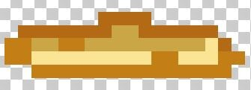
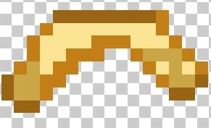
Early Concept Art: Throwable Items
MUR (4/26): Kept character slides in case we want to reuse
Lettuce
French Fries
Bottom: Fry-a-rang
Fountain Drink

Slide 26


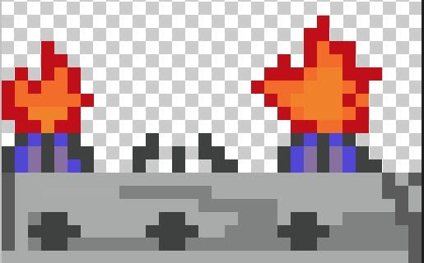

Early Concept Art: Hazards
MUR (4/26): Kept character slides in case we want to reuse
Dropped Food
Tomato Slices
Timed Jumps Across Kitchen Burners
Knives Being Used by Humans

Slide 27
Breakdown of Level of Effort for Team Members
MUR (4/26): “Who did what and the percentage. A summary of the product backlog can be used.”
(1-2 slides)
x

Slide 28
Work Left on Burger Breakout
MUR (4/26): Need to update slide.
(1-2 slides)
Configurable menu options
Sound
Graphics
Controls
Typical game features
Save
Exit
Load
Clear set of goals
High scores
Achievements

Slide 29
Work Left on Burger Breakout
MUR (4/26): Need to update slide.
(1-2 slides)
Environments and levels
Additional types
Improved detail
Powerups
Different throwable items
Drinks
Lettuce
Enemies
Better AI
Bosses
Different types
Animations

Slide 30
Link to Burger Breakout
MUR (4/26): “A link to downloadable application.”
(1 slide)
x

Slide 31

Questions/Comments/Complaints?

